Slide 1
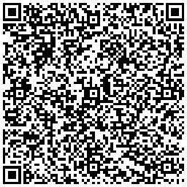
AI-Driven Welding Training in Career and Technical Education (CTE)
Scott Laslo MS CWI CWE WPQ1 | Columbus State C.C.| 10/23/25

Slide 2
Introduction
AI is transforming welding education in CTE.
Traditional training is time-consuming and instructor-dependent.
AI enables real-time feedback, adaptive learning, and simulation.
Theoretical lens: Technology Acceptance Model (TAM). Educators
Change is Hard :Every spark carries data. Every weld tells a story. Today we re-imagine welding — not just as skill, but as a symphony of craft and code.
Notes:
Introduce the topic and explain the relevance of AI in CTE programs, particularly in welding. Emphasize the technological shift. Projected U.S. shortage of >360,000 welders by 2027
Capacity constraints: faculty, facilities, consumables
Need for scalable, high‑fidelity, feedback‑rich training
Industry 4.0 requires hybrid digital‑manual skill sets

Slide 3


The Workforce Challenge
“Our nation’s infrastructure depends on welders. Yet classrooms, not factories, are the true bottleneck. Scaling learning is our greatest engineering challenge.”

Slide 4
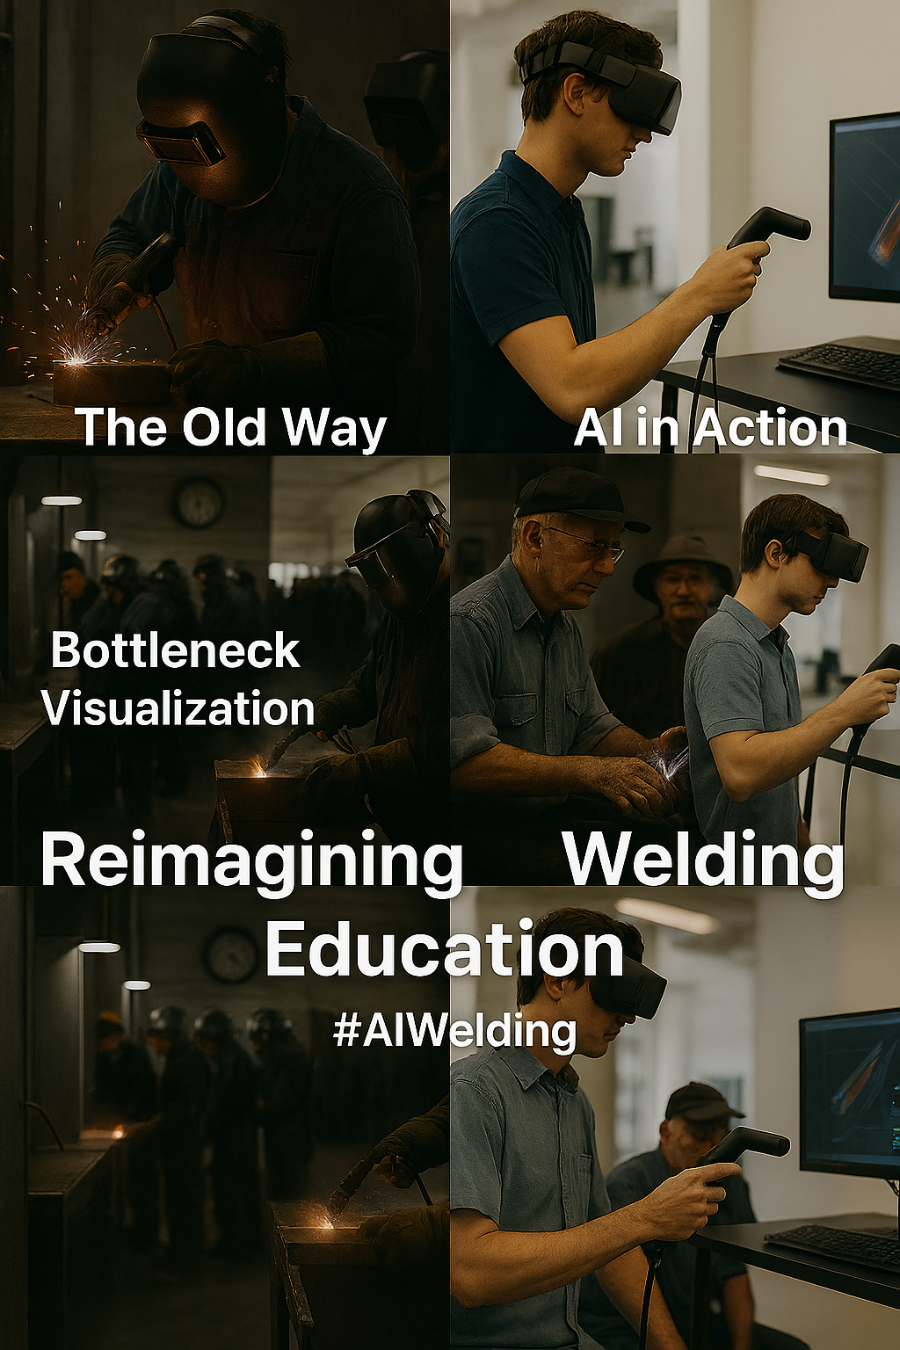
Limits of Tradition
Traditional training is resource-intensive: one torch, one mentor, one booth at a time. We respect that lineage — and we build on it.

Slide 5
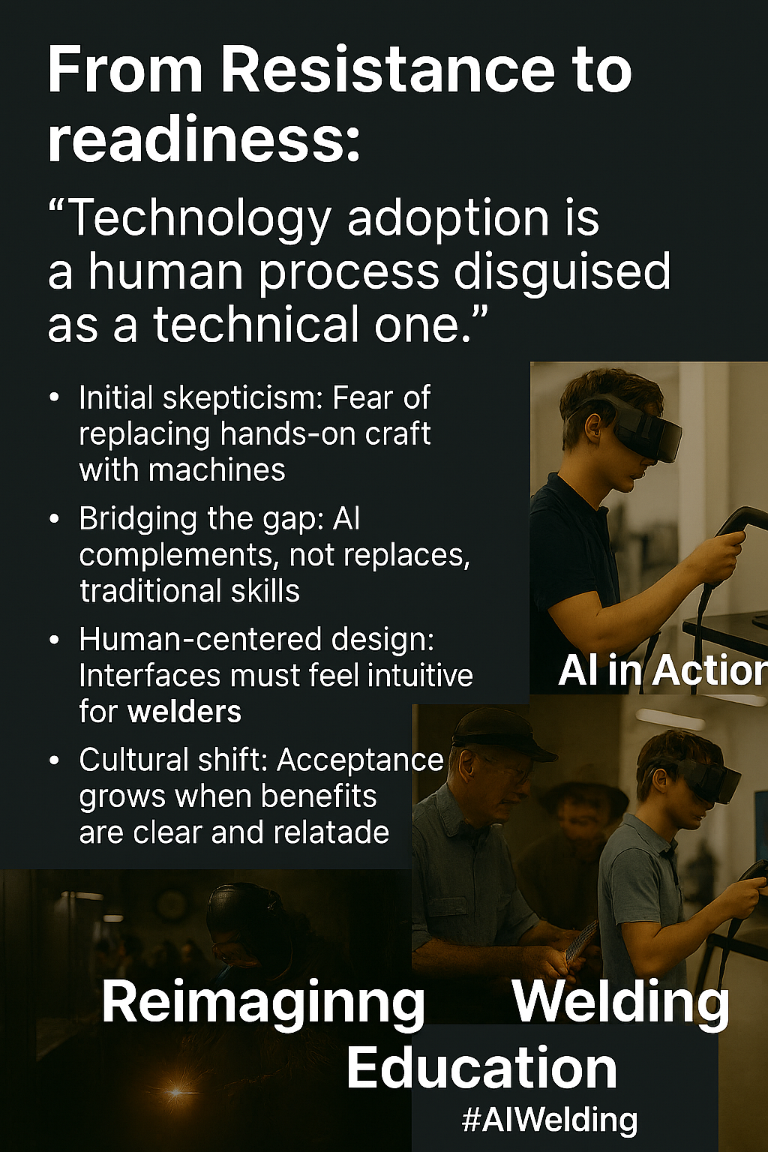
From Resistance to Readiness

Slide 6
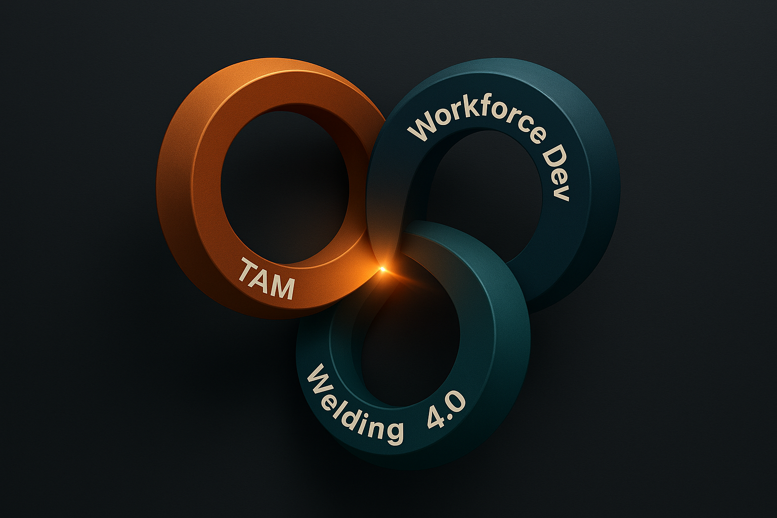
Framework for Adoption

Slide 7

TAM Framework (Fred Davis, 1986)
Perceived Usefulness (PU)
Perceived Ease of Use (PEOU)
These influence: Attitude → Intention → Usage
Notes:
Briefly explain TAM and why it is suitable for this study. Connect to trainee acceptance of AI.

Slide 8
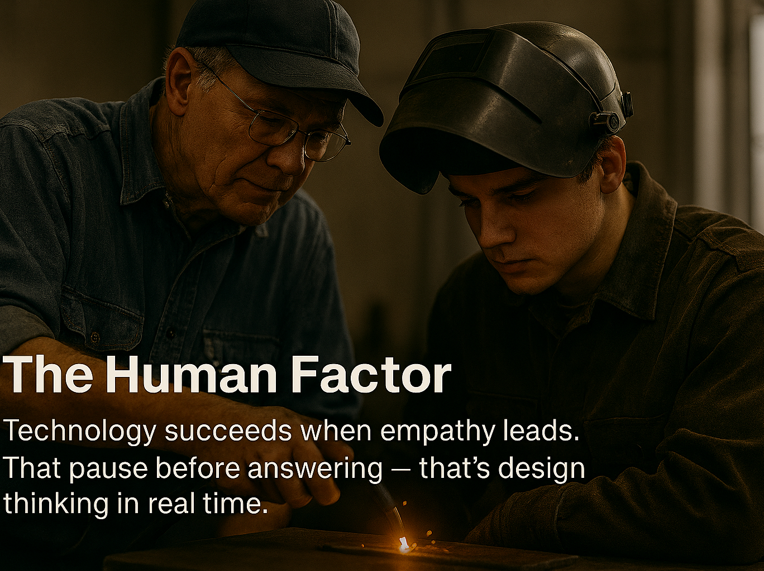

Slide 9
Research Objectives
1. Compare AI- based adaptive learning vs traditional welding training.
1
2. Evaluate AI-based adaptive learning for retention and error reduction.
2
3. Assess learning efficiency and accuracy with AI feedback.
3
4. Correlate AI feedback with welding quality metrics.
4
Notes:
Walk through each objective. Clarify the difference between 'skill acquisition' and 'retention'.

Slide 10
Research Questions
1. How does AI feedback affect skill acquisition?
2. Does AI training reduce errors and improve accuracy?
3. What is the link between AI feedback and performance?
4. How does AI impact retention over time?
Notes:
Discuss the motivation for these questions and how each one aligns with the objectives.

Slide 11
AI in Skill Acquisition
AI detects defects and improves consistency.
Erden & Tomiyama (2009) – robotic welding aid.
Liu et al. (2014) – welder intelligence modeling.
Gap: Few comparative studies with traditional methods.
Notes:
Discuss how AI assists in developing consistent welding technique and decision-making.

Slide 12
Digital Twins & Adaptive Systems
Digital twin simulates welding environments.
Wang et al. (2021) – behavior-driven simulation.
Lenat et al. (2024) – human-machine collaboration.
Gap: Lacks multi-level skill studies.
Notes:
Explain digital twins using examples, and how they simulate welding conditions.

Slide 13
Usefulness & Ease of Use
PU: Enhanced speed, accuracy, engagement.
PEOU: Simplified interfaces needed for adoption.
Papakostas et al. (2022) – ease of AR impacts use.
Gap: PU/PEOU impact on long-term outcomes is unclear.
Notes:
Connect PU and PEOU to trainees’ willingness to adopt new systems. Show real-world cases.

Slide 14
Error Reduction & Learning Retention
Das et al. (2022) – defect identification via AI.
Chikai et al. (2020) – haptic feedback boosts memory.
Gap: Short-term focus; need longitudinal studies.
Notes:
Show how AI identifies errors and allows repeated practice for improvement.

Slide 15
Welding Performance Metrics
Metrics: Arc stability, bead uniformity, heat input.
Wang (2020) – predictive models.
Gap: Lacks real-world execution validation.
Notes:
Explain how welding quality is typically measured and why AI’s contribution is important.

Slide 16

Trainee Perceptions & Adoption
Ipsita et al. (2022) – VR improves access.
Farida & Nurhadi (2022) – user satisfaction with standards.
Gap: Resistance to AI remains unexamined in depth.
Notes:
Summarize how trainees feel about AI, and challenges faced in educational settings.

Slide 17
Summary of Research Gaps
Skill: Limited AI vs. traditional data.
Retention: Few long-term studies.
Errors: Sparse multi-session tracking.
Performance: Weak correlation research.
TAM: Limited application in welding training.
Notes:
Summarize gaps found in literature and reinforce the justification for your study.

Slide 18
Contribution of This Study
Addresses empirical and theoretical gaps.
Applies TAM in CTE welding context.
Measures retention, quality, and feedback impact.
Framework for future AI-welding training integration.
Notes:
Highlight how your study will be different and its contribution to both theory and practice.

Slide 19


Curricular Content
Presentation Name Goes Right Here
October 19, 2025
19

Slide 20
Applications of This Study
Instrumentation Acquisition: Welding Education, Learning and Development Standardization (WELDS Ohio Project)
Manufacturing Alliance of educatoRs and Industry for Naval dEterrence and Resilience (MARINER)
Education and Training Development and Implementation
Notes:
Highlight how your study will be different and its contribution to both theory and practice.

Slide 21
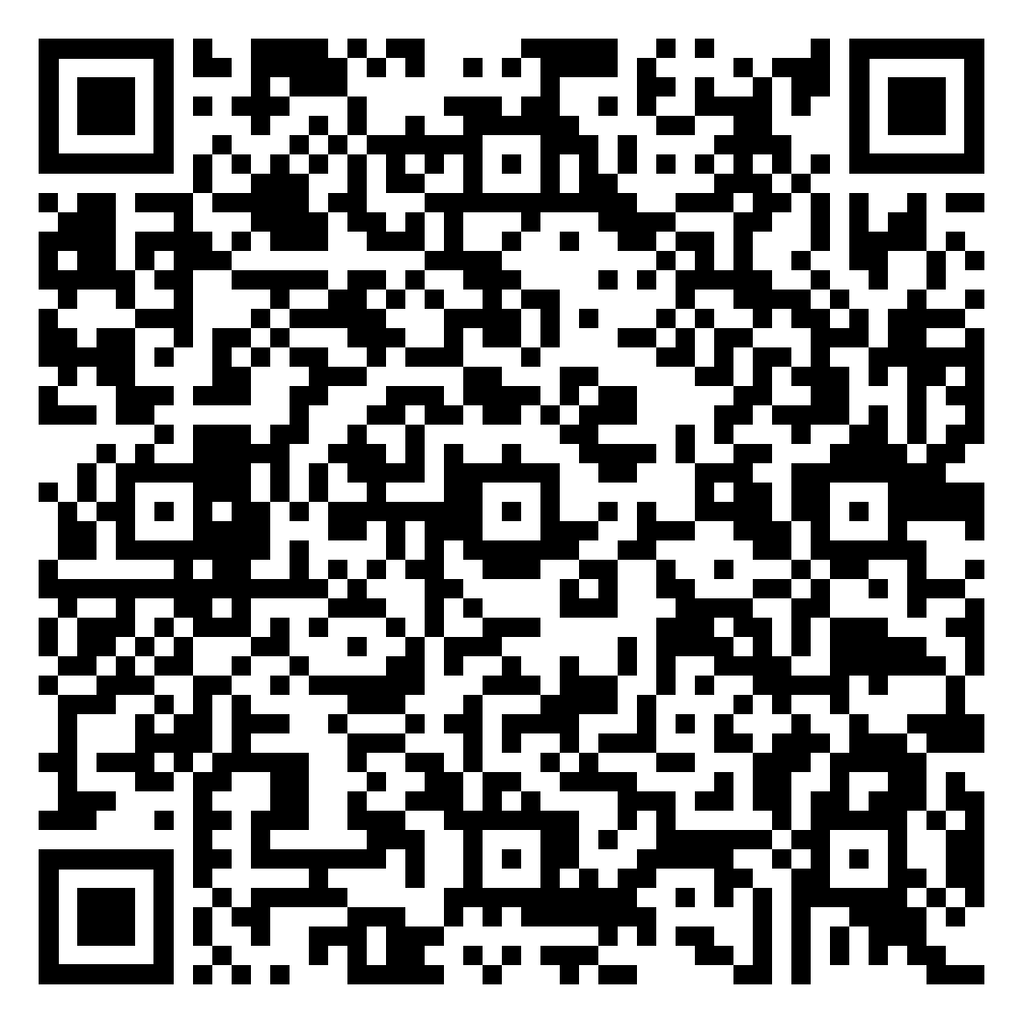
Thank You / Q&A
Copy of Presentation:
Contact:
Notes:
Invite questions and thank attendees. Be open to feedback and suggestions.

Slide 22
References
Davis, F. D. (1986). A Technology Acceptance Model for Empirically Testing New End-User Information Systems: Theory and Results (Doctoral dissertation, MIT Sloan School of Management).
Ipsita, D., Rahman, A., & Hasan, M. (2022). Virtual reality for vocational skill development: Expanding access to welding education. International Journal of Technical Education and Training, 18(2), 45–53.
Farida, I., & Nurhadi, H. (2022). User satisfaction and performance standards in vocational AI-based training systems. Journal of Educational Technology Research, 7(3), 101–113.
Laslo, S. (2025). AI-Driven Welding Training in Career and Technical Education (CTE) [Presentation]. Columbus State Community College.
U.S. Department of Education, Office of Career, Technical, and Adult Education. (2024). Advancing AI in CTE: A national strategy for workforce readiness.
Notes:
Invite questions and thank attendees. Be open to feedback and suggestions.

